Slide 1
TLC Model Checker
Some tips to optimize tlc’s performance
易星辰
2018.09.25

Slide 2
Reference
Markus A. Kuppe
http://youtu.be/zGIK2p6csAo
Specify System: Ch14

Slide 3
Outline
Specification
order of expression
Module overwrite
TLC Mode
Distributed TLC
Others
Parameter
State graph

Slide 4
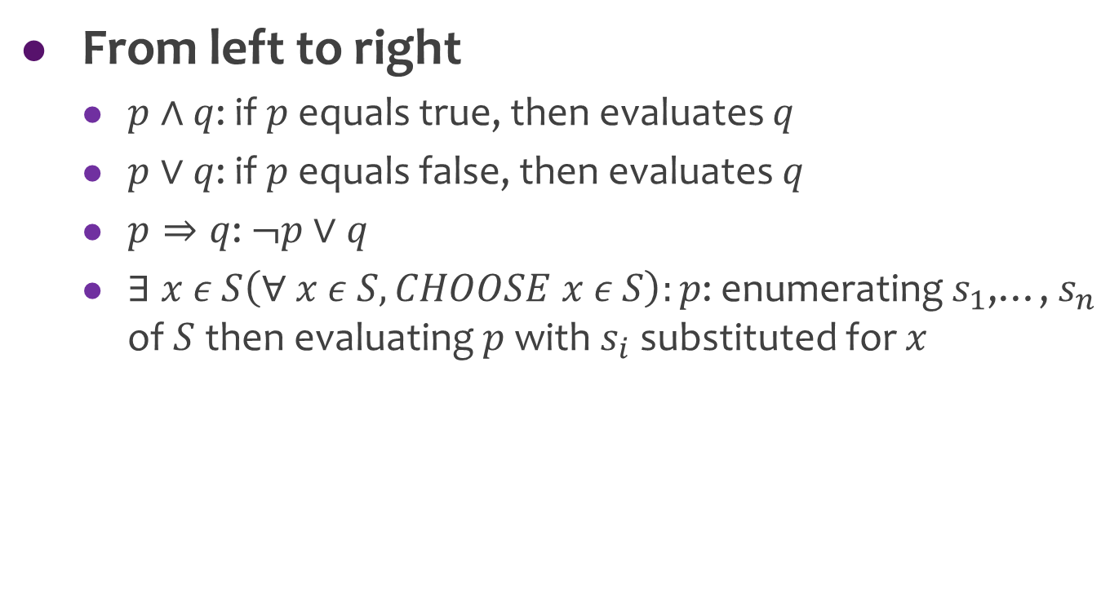
TLC Evaluates Expressions
From left to right
$p∧q$: if $p$ equals true, then evaluates $q$
$p∨q$: if $p$ equals false, then evaluates $q$
$p⇒q$: $¬p∨q$
$∃ x ε S\left(∀ x ε S, CHOOSE x ε S\right):p$: enumerating $s_{1}$,…, $s_{n}$ of $S$ then evaluating $p$ with $s_{i}$ substituted for $x$

Slide 5
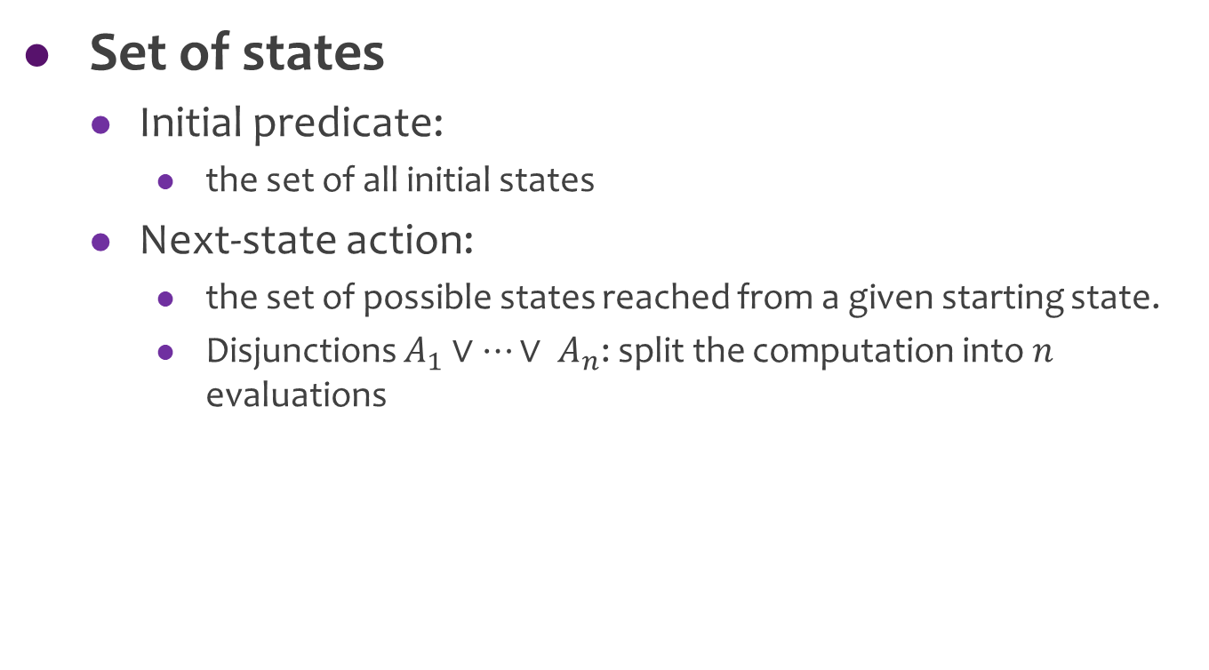
TLC Computes States
Set of states
Initial predicate:
the set of all initial states
Next-state action:
the set of possible states reached from a given starting state.
Disjunctions $A_{1}∨…∨ A_{n}$: split the computation into $n$ evaluations

Slide 6
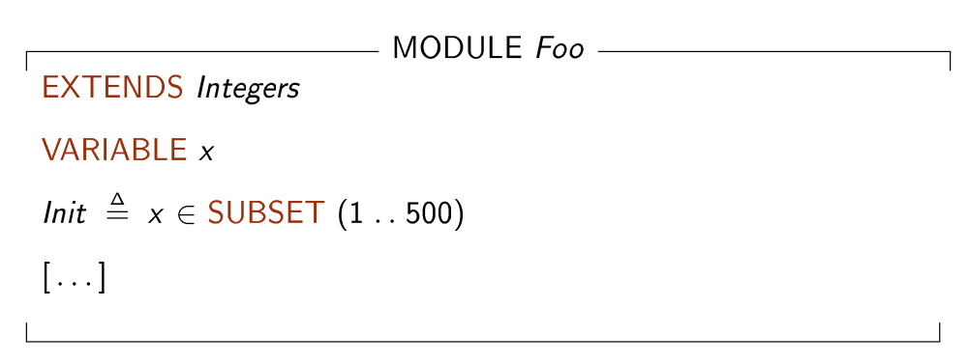
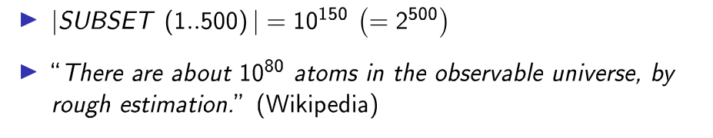
Large State Spaces

Slide 7
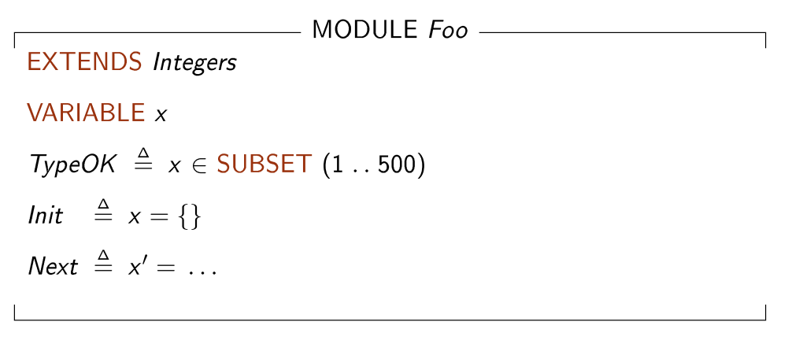
Large State Spaces

Slide 8
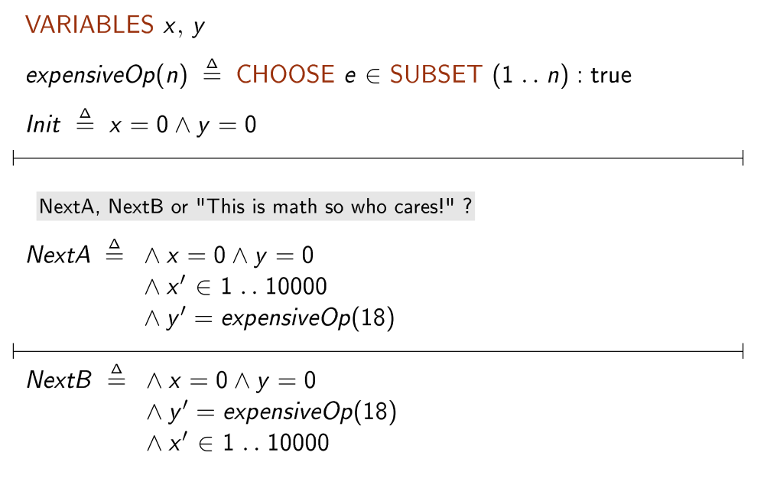
Order of Expressions

Slide 9
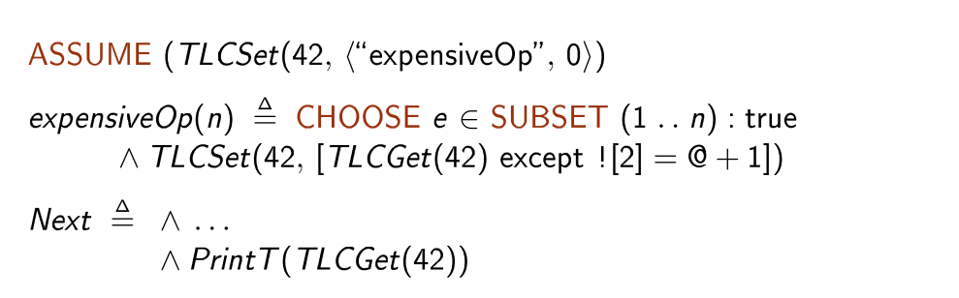
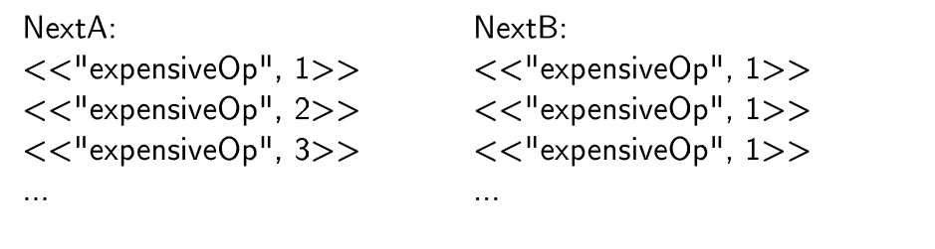
Order of Expressions
Print to userFile:
-userFile /path/to/file.out
Killed TLC after a few minutes
TLC takes 10 seconds

Slide 10
Module Overwrite
Implement TLA+ operators in Java
Standard modules: Naturals、TLC
Some operators: Java instead of TLA+
Drawbacks
Not easy to implement
Hard to test
Usage
tla2tools.jar

Slide 11
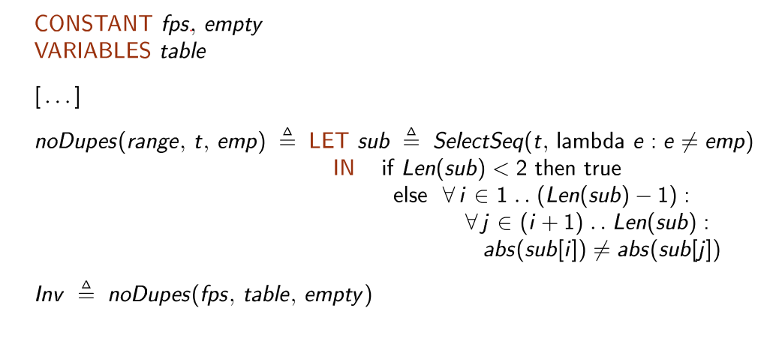

Example
$$O(n^{2})$$

Slide 12
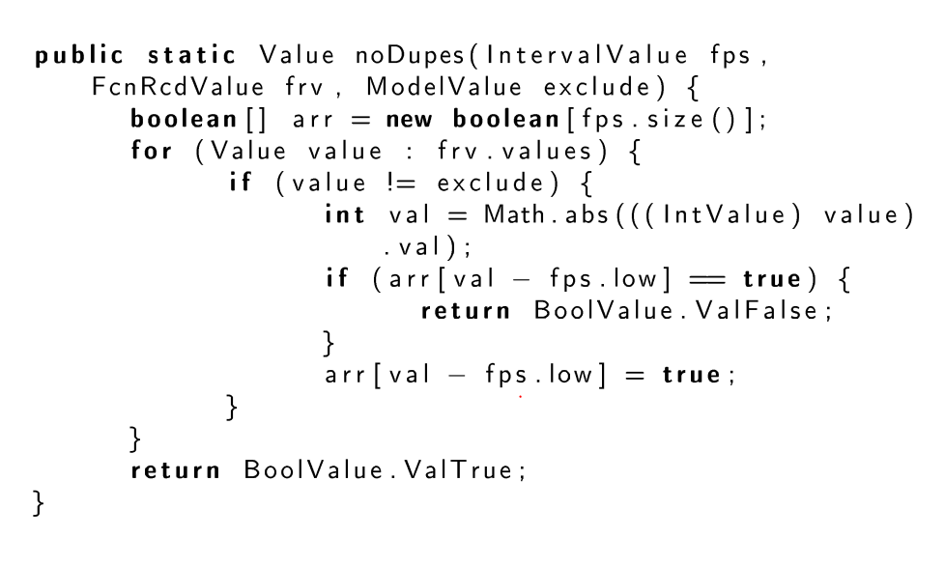

Example
$$O(n)$$

Slide 13
TLC Mode
Distributed TLC
ad hoc: set of computers
cloud TLC: cloud computers
Roles
Master: start to model checking
Slave: workers to do actual model checking
*Fingerprint Server: save the fingerprint sets

Slide 14
Demo Time

Slide 15
Others
Parameters
No checkpoint: “-checkpoint 0”
Coverage: “-coverage 99999”
Final check liveness: “-Incheck final”
Java Mission Control
Liveness checking
Checkpoint
Reduce state in graph
“-view”(Only works for auxiliary variables)

Slide 16
谢谢聆听！

Slide 17
Q&A

